Slide 1


Enhancing hand hygiene compliance at Valley Hospital using the World Health Organization multimodal strategy
Bonface Thuranira Douglas, KRCHN,
Quality & Infusion Safety Lead / IPC Coordinator
Valley Hospital

Slide 2
BACKGROUND
Valley Hospital is a premier private healthcare hospital facility located in Nakuru City, offering a one-stop shop for all medical services.
In particular, the hospital offers diverse and specialty services with a mission to provide quality yet cost-effective healthcare, including neonatology, pediatrics, obstetrics and gynecology, general medicine, psychiatry, dermatology, surgery, dental, ophthalmology, orthopedics and many more.
The institution prides itself on having highly qualified professionals who deliver its mission each day, by translating their knowledge and expertise to exceptional healthcare services.

Slide 3
BACKGROUND CT..
Hand hygiene is a critical component of infection prevention and control.
Despite its importance, compliance among healthcare workers (HCWs) often falls below optimal levels.

Slide 4
PROBLEM STATEMENT
Observations and baseline assessments carried out in November 2023, indicated that inconsistent adherence to hand hygiene protocols increased the risk of HAIs, compromising patient safety and quality of care.
Contributing factors included inadequate training, lack of readily available hand hygiene supplies, ineffective monitoring and feedback mechanisms, and insufficient institutional support.

Slide 5
AIM STATEMENT
This project aimed to enhance hand hygiene adherence at Valley Hospital from a baseline score of 20.6% to 70% by the end of December 2024, by implementing the WHO multimodal strategy.

Slide 6
WHY THE WHO MULTIMODAL STRATEGY?
The WHO developed the Multimodal Strategy as part of the Global Action on Patient Safety and the WHO Guidelines on Core Components of IPC Programs (2016). It is tailored to address the diverse healthcare systems in both high-resource and low-resource settings.
The strategy aligns with the Global Patient Safety Action Plan 2021–2030, aiming to eliminate avoidable harm in healthcare.
The WHO multimodal strategy integrates multiple interventions that, when implemented together, reinforce one another to create a significant impact. These interventions focus on improving both behavior and systems.

Slide 7
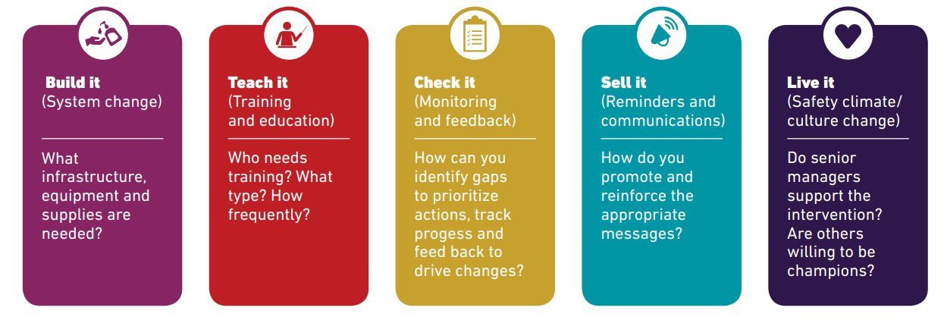
WHY THE WHO MULTIMODAL ELEMENTS

Slide 8
RESULTS

Slide 9
BASELINE SCORE- TABLE PRESENTATION
MULTIMODAL STRATEGY | COMPLIANCE SCORE
BUILT IT (SYSTEM CHANGE) | 33%
TEACH IT (TRAINING AND EDUCATION) | 5%
CHECK IT (MONITORING AND FEEDBACK) | 5%
SELL IT ( REMINDERS AND COMMUNICATION) | 43%
LIVE IT ( SAFETY CLIMATE/CULTURE CHANGE) | 17%
TOTAL COMPLIANCE SCORE | 20.6%

Slide 10

METHODOLOGY
This study followed a quasi-experimental pre-post intervention design with elements of an interrupted time series design to assess trends before, during, and after intervention implementation.
To ensure continuous improvement, a PDSA cycle was followed.

Slide 11
INDICATORS FOR MONITORING AND EVALUATION
INDICATORS | TYPE
Percentage of HCWs trained on hand hygiene practices. Availability of hand hygiene supplies at the point of care. Number of reminders and educational materials placed in key areas. | Process
Increase in hand hygiene compliance rates measured through direct observation. Reduction in HAIs. Improvement in staff knowledge and adherence based on survey responses. | Outcome
Potential increase in skin irritation complaints from frequent hand hygiene practices. Workflow disruptions due to increased time spent on hand hygiene. Staff perception of feasibility and acceptance of new interventions. | Balancing

Slide 12
RCA: FISHBONE DIAGRAM
PEOPLE
PROCESS
Lack of awareness or training
Resistance to behavioral change
High workload and time constraints
Forgetfulness or negligence
Lack of accountability
Inefficient workflow design discouraging compliance
Inconsistent reinforcement of hand hygiene protocols
Lack of auditing or feedback mechanisms
LOW HAND HYGIENE COMPLIANCE
Poor placement of hand hygiene stations
High patient-to-staff ratio leading to rushed practices
Lack of reminders or visual cues
Inconsistent availability of alcohol-based hand rubs and soap
Malfunctioning or insufficient sinks and dispensers
Poor stock management
ENVIRONMENT
MATERIALS AND SUPPLIES

Slide 13
DRIVER DIAGRAM
Train HCWs on HH practices/ practical demonstrations
Include Hand hygiene compliance in performance reviews to promote responsibility
Reward systems for departments with high compliance rates
PEOPLE
Develop Clear and standardized hand hygiene protocols that are easy to follow.
Develop Clear instructions and reminders for staff on when and how to perform hand hygiene
Scheduled observation audits
Real-time feedback to staff based on audit results,
To enhance hand hygiene adherence at Valley Hospital by implementing the WHO multimodal strategy.​
PROCESS
Place hand sanitizers and handwashing stations at key locations
Visual reminders in high-traffic areas
Prominent placement of alcohol-based hand rub dispensers next to patient care areas.
Improve the design of key areas and taps
ENVIRONMENT
Ensure consistent stock of hand sanitizers, soap, and disposable towels
Install hands-free dispensers to improve ease of use and encourage usage
Regular checks to ensure supplies are available at all times
MATERIALS/
SUPPLIES
Aim
Primary Drivers
Change Ideas

Slide 14

PROJECT IMPLIMENTATION

Slide 15
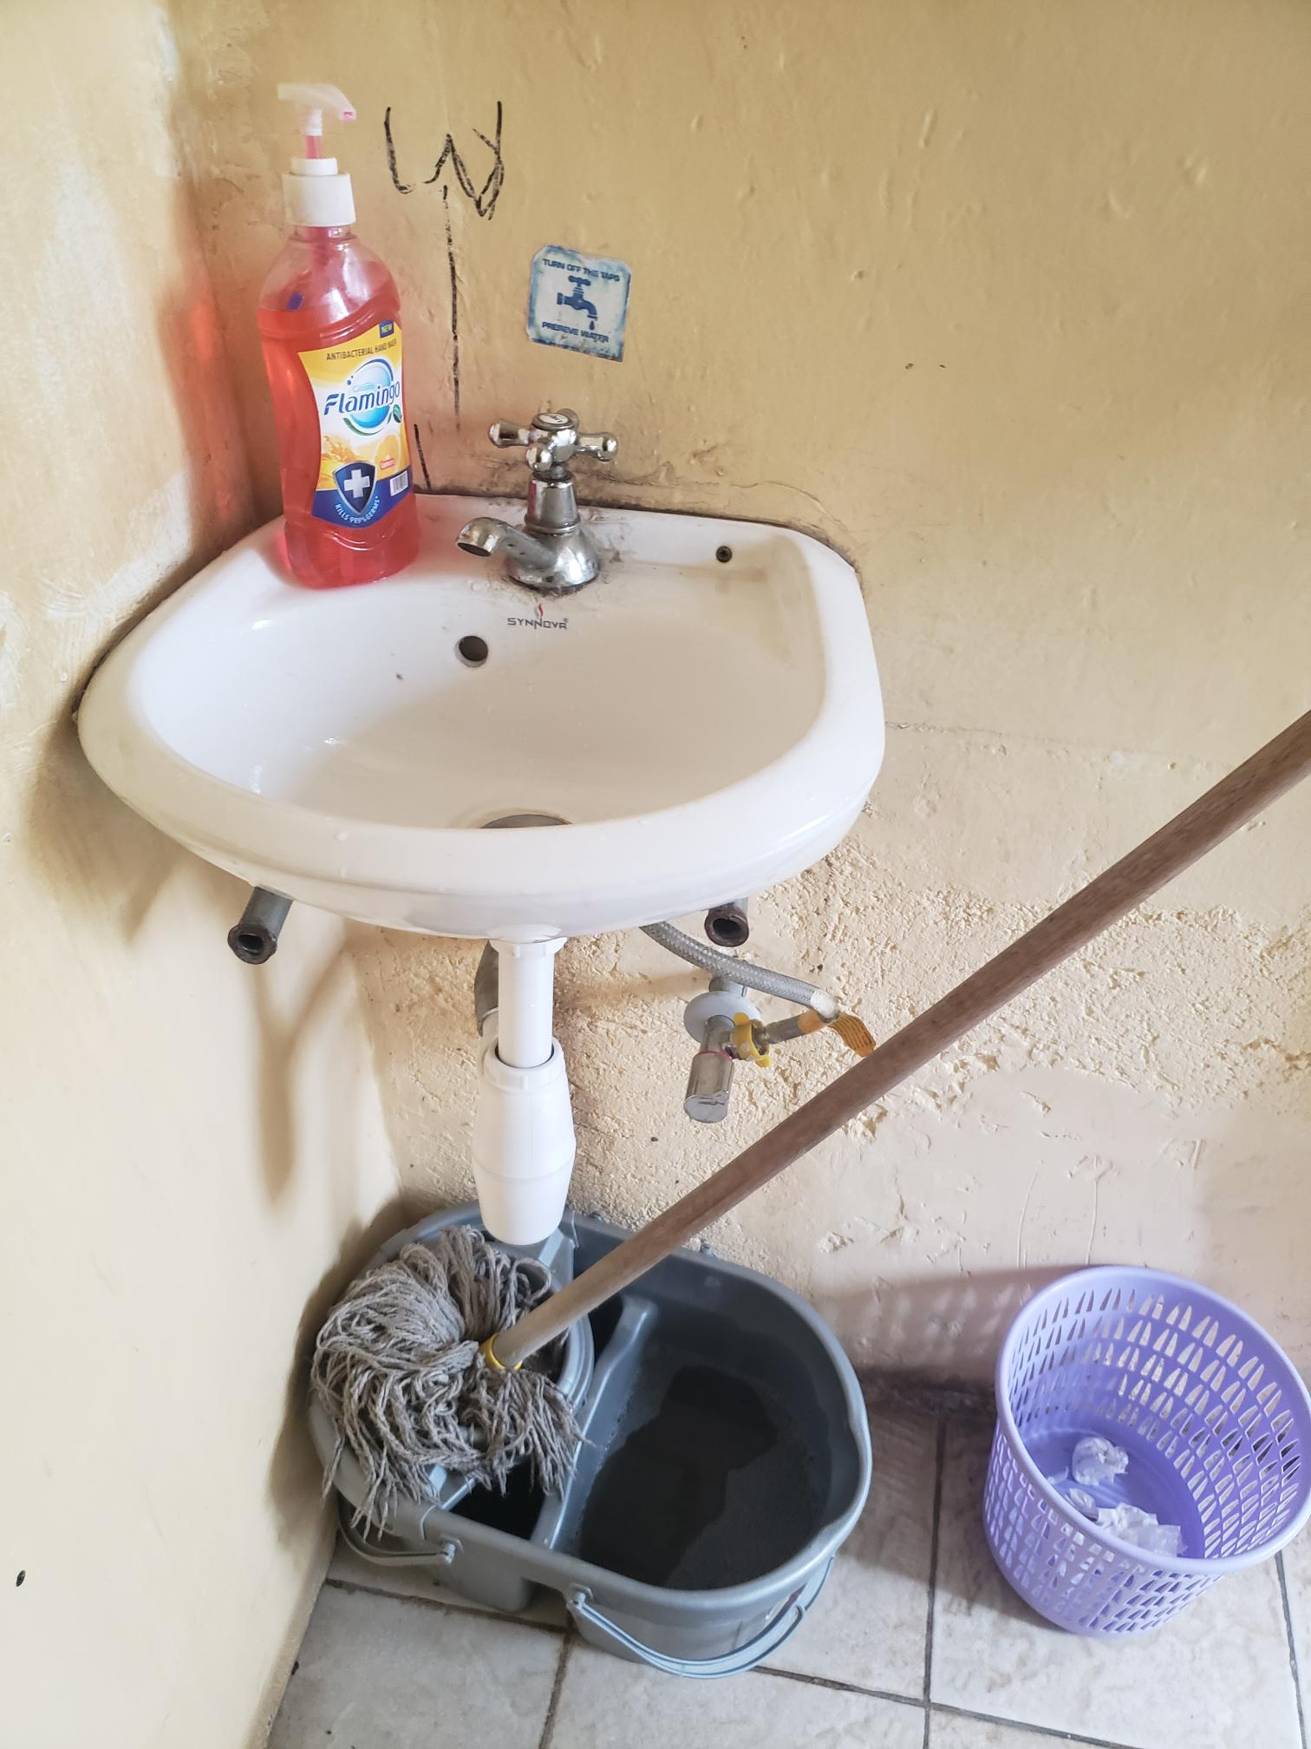
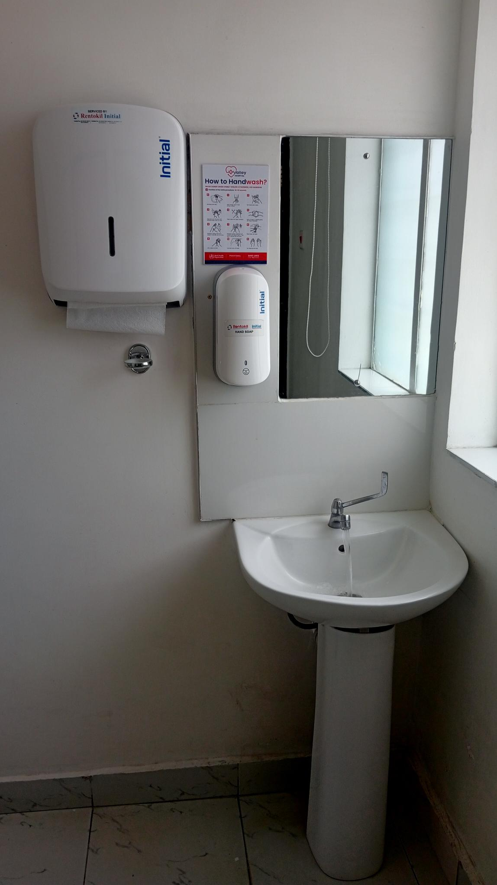
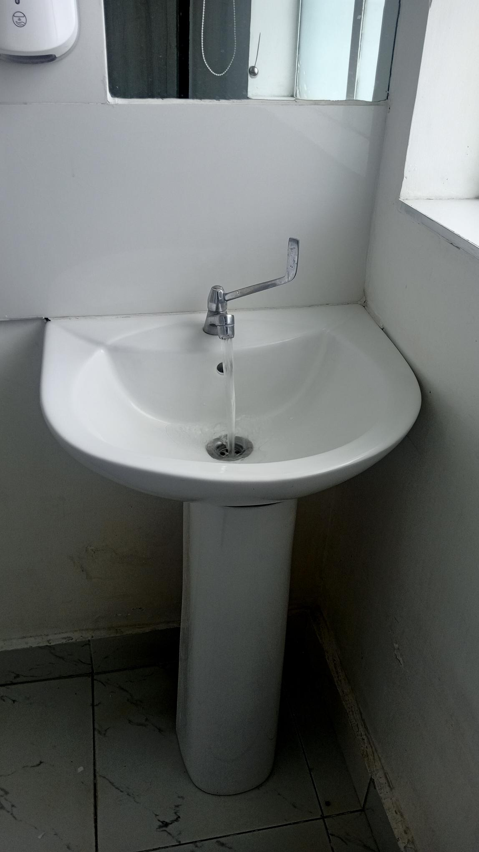
HAND WASHING SINKS
BEFORE
AFTER

Slide 16

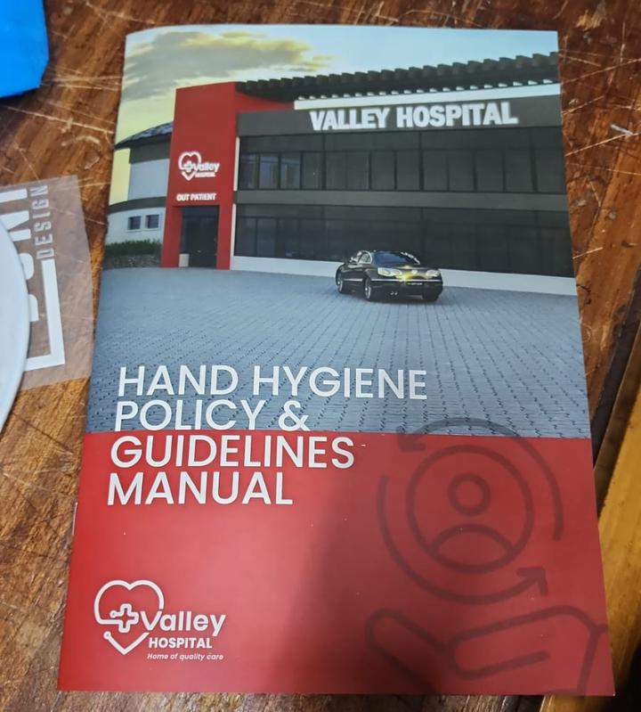
Hand Hygiene guidelines manual

Slide 17
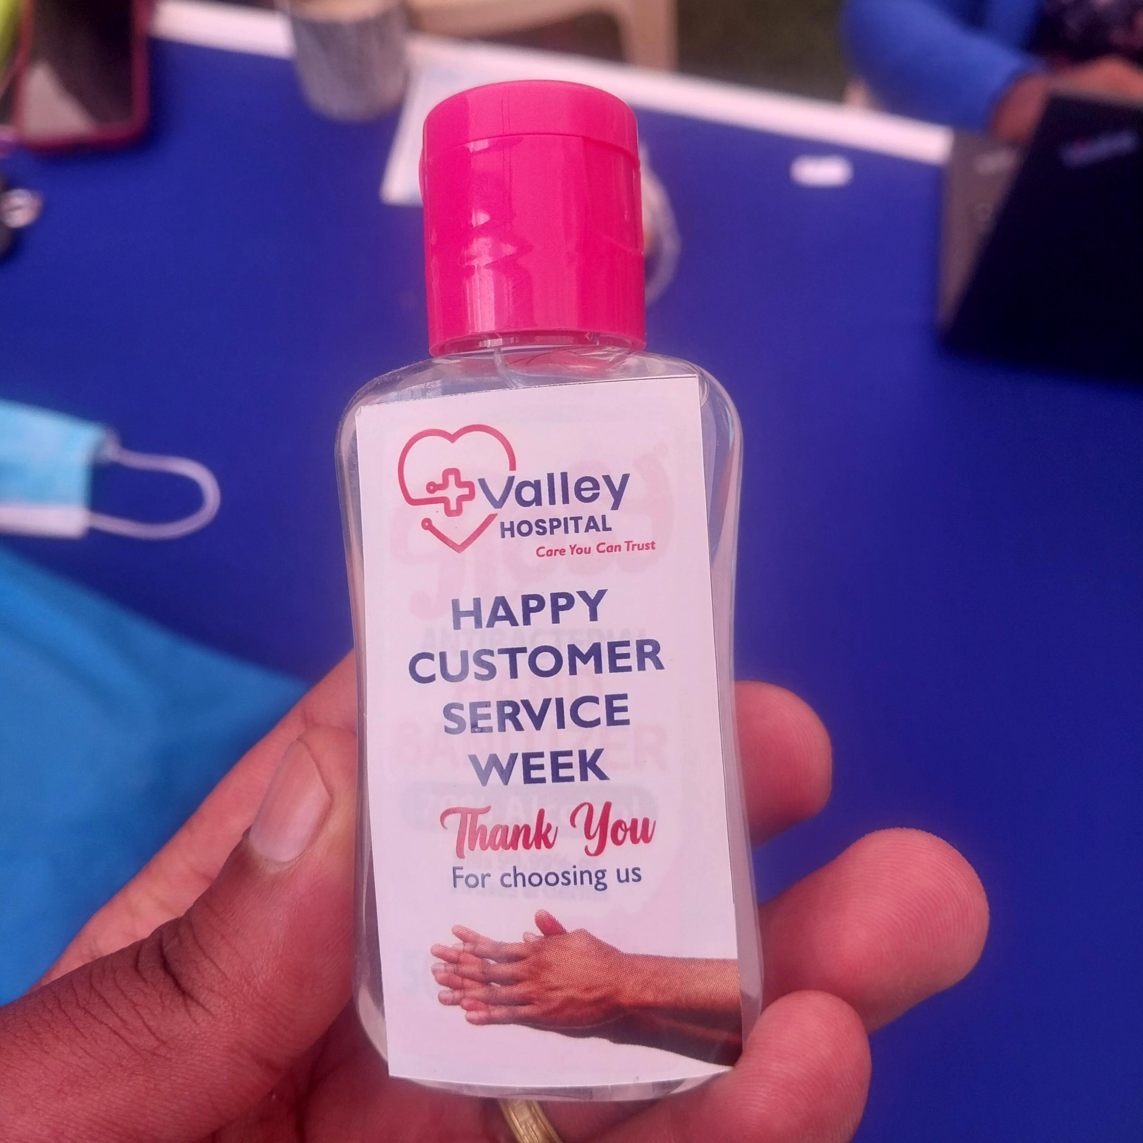
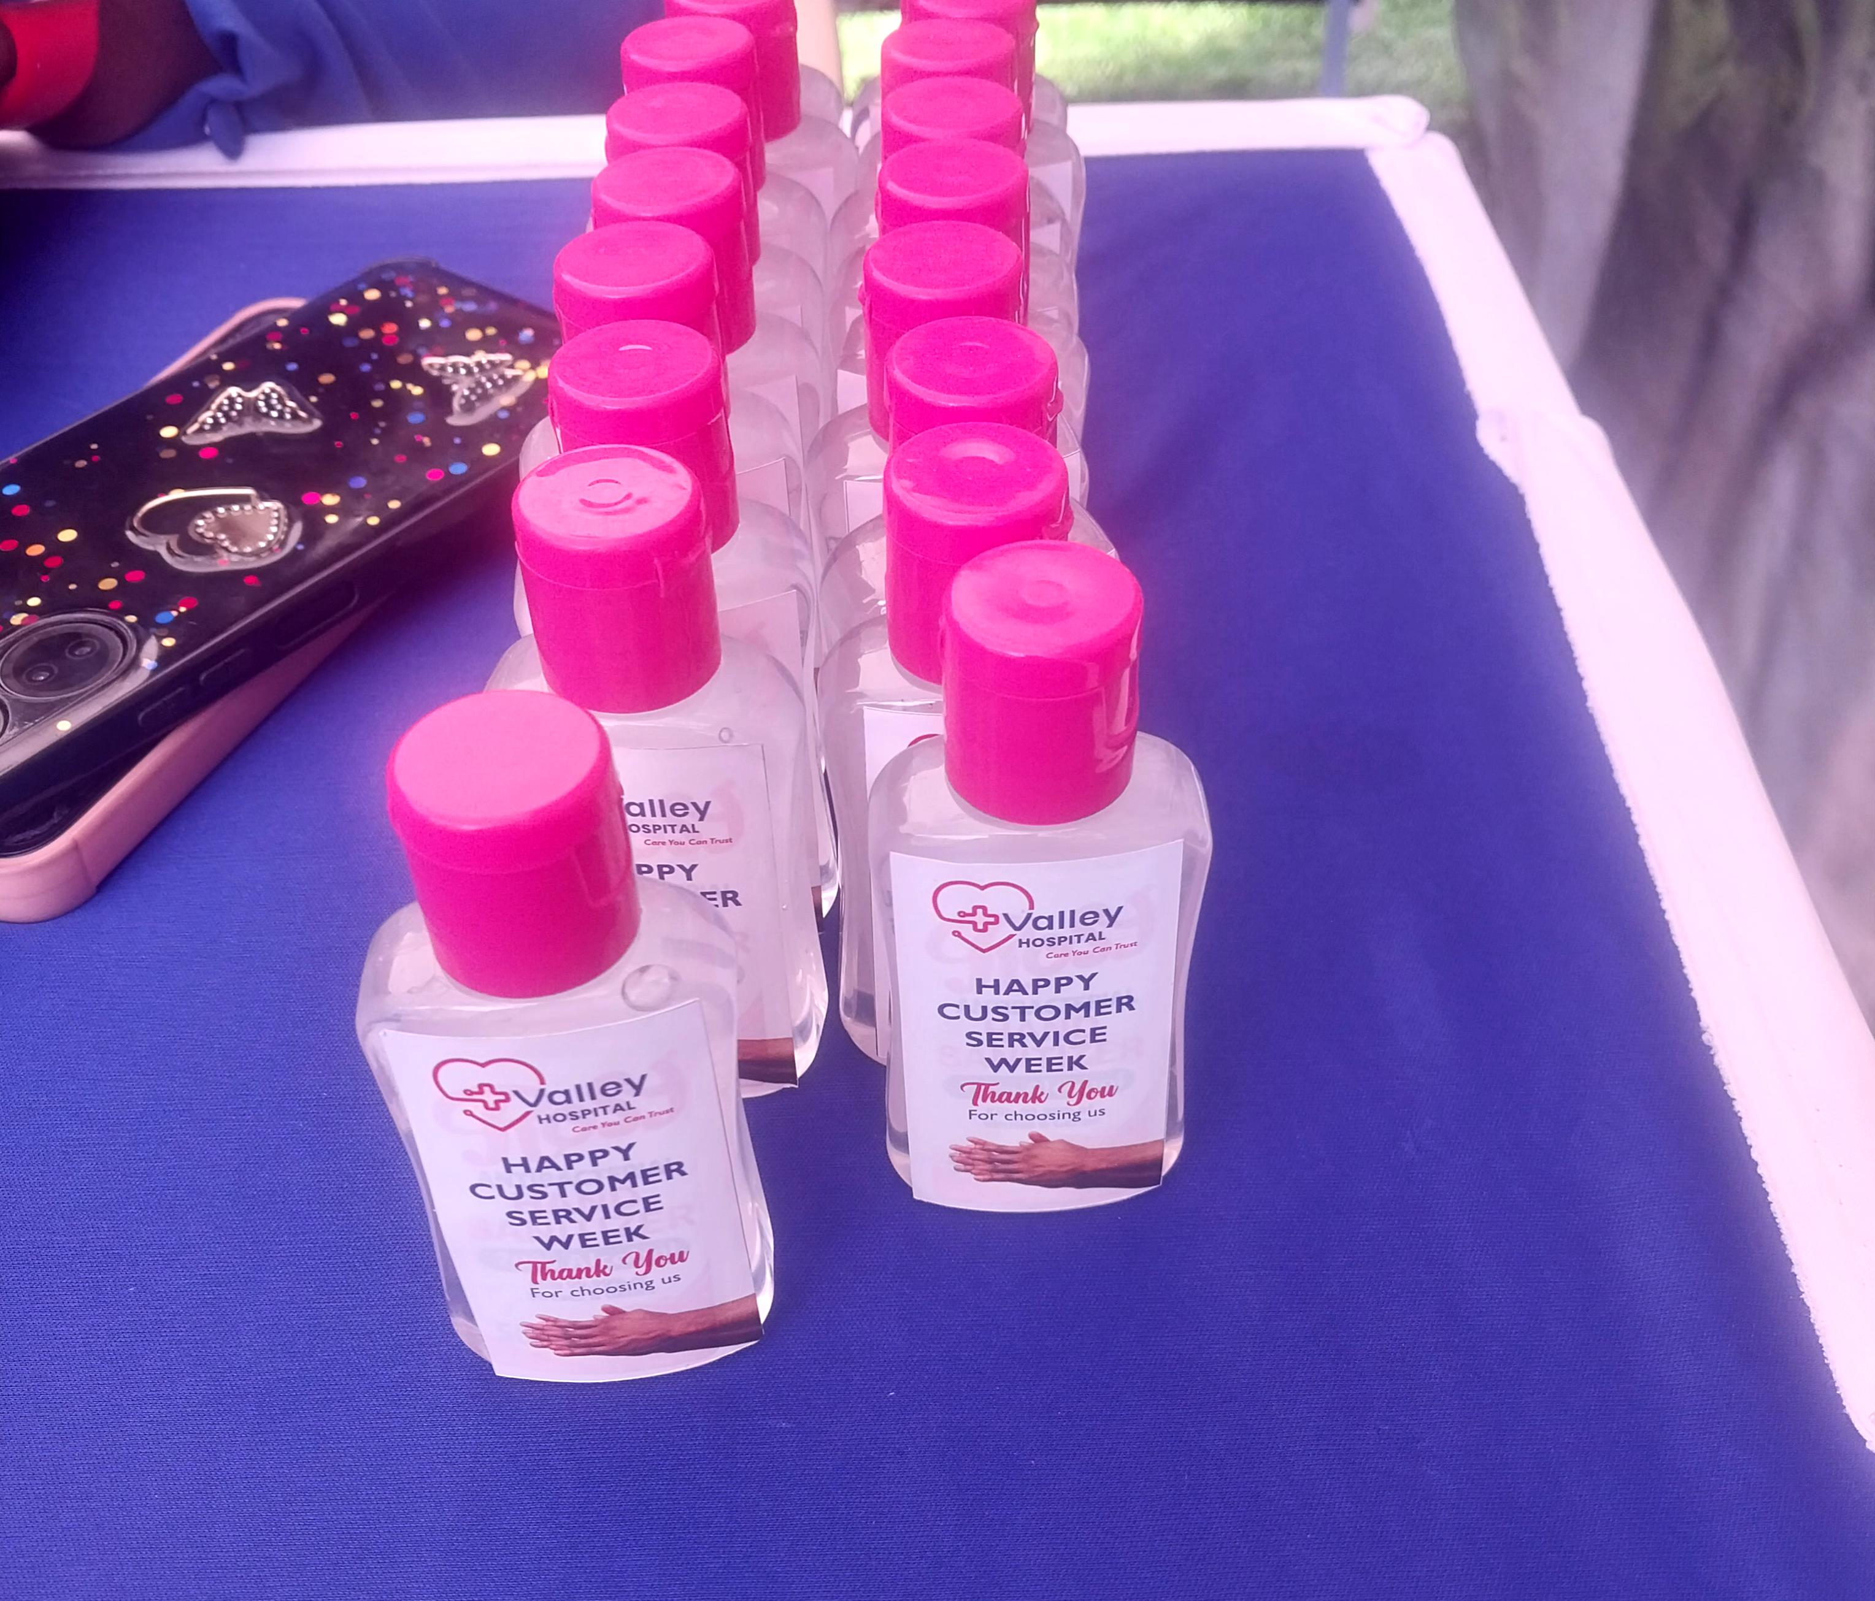
Pocket sanitizers for our clients

Slide 18
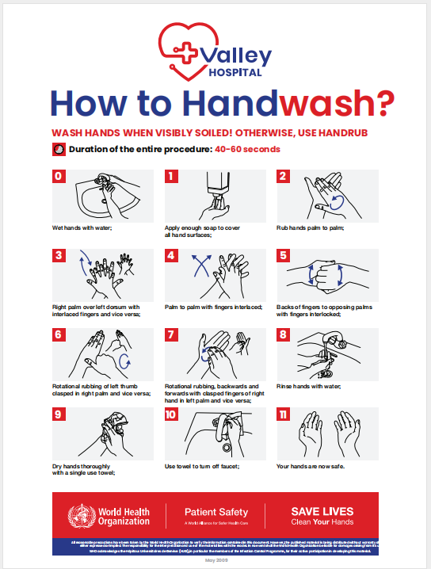
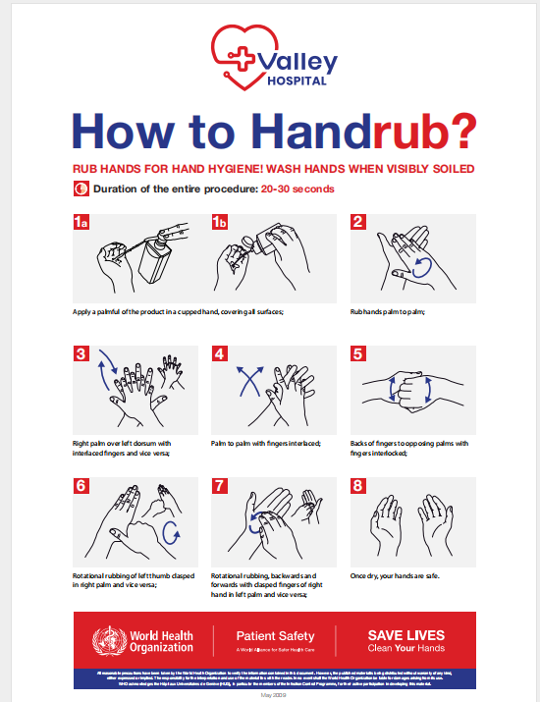
HAND HYGIENE POSTERS

Slide 19
IPC LEADERSHIP CHANGE
HEAD OF NURSING
MANAGING DIRECTOR
IPC COORDINATOR
IPC COORDINATOR
IPC COMMITTEE
IPC COMMITTEE

Slide 20

THE RESULTS

Slide 22
TABLE PRESENTATION-FINAL COMPLIANCE SCORE
MULTIMODAL STRATEGY | COMPLIANCE SCORE
BUILT IT (SYSTEM CHANGE) | 85%
TEACH IT (TRAINING AND EDUCATION) | 90%
CHECK IT (MONITORING AND FEEDBACK) | 80%
SELL IT ( REMINDERS AND COMMUNICATION) | 86%
LIVE IT ( SAFETY CLIMATE/CULTURE CHANGE) | 50%
TOTAL COMPLIANCE SCORE | 78.2%

Slide 23
TARGET SCORE

Slide 24
SUCCESSFUL CHANGE IDEAS
Education and Training
Hand hygiene protocols- policies/SOPs
Placement of new automatic sanitizer and soap dispensers
Posters and reminders
Continuous supply of soap and hand sanitizer-external company
Real time feedback
Regular spot-checks

Slide 25
UNSUCCESSFUL CHANGE IDEAS
Introduction of a reward system
Inclusion of hand hygiene in performance review
Weekly audits

Slide 26
CHALLENGES ENCOUNTERED
Workload and time constraints
Maintenace issues
Knowledge gap among non-clinical staff
High staff turnover

Slide 27
OVERAL LESSONS LEARNT
The leadership is the rock on which the IPC stands
It all starts with leadership and ends with leadership
Multi-disciplinary approach is key in success
No attitude is beyond correction
It is possible to achieve and maintain healthcare set standards

Slide 28
SCALE UP PLAN
Full Hospital Integration
Integrate hand hygiene strategies into standard hospital policies.
Establish long-term monitoring and compliance mechanisms.
External Collaboration and Dissemination
Share best practices and results with other healthcare facilities.
Advocate for system-wide adoption across hospitals within the region.

Slide 29
SUSTAINABILITY PLAN
Continuous monitoring, evaluation and feedback
Leadership Commitment: Get buy-in from management to ensure resources and policy enforcement.
Ongoing Training & Education: Conduct regular sessions to reinforce best practices.
Real-Time Feedback: Use technology or peer monitoring to provide continuous feedback.
Positive Reinforcement: Recognize and reward compliant behavior to encourage adherence.

Slide 30
CONCLUSION
Implementing the WHO multimodal strategy significantly improved hand hygiene compliance and contributed to a reduction in HAIs at Valley Hospital.
A structured scale-up plan ensures sustainability and broader adoption across departments.
These findings underscore the need for continuous reinforcement, leadership commitment, and ongoing monitoring to maintain high compliance rates and promote patient safety.

Slide 31
ACKNOWLEDGEMENT
I wish to sincerely acknowledge the invaluable support and guidance I received throughout the development of this project.
My deepest appreciation goes to the hospital administration led by the Managing Director for their leadership and encouragement. I also extend my gratitude to the Head of Clinical and Governance for the oversight and direction provided, which greatly strengthened this work.
Special thanks go to the Infection Prevention and Control (IPC) Committee for their commitment, collaboration, and technical input that made this project possible.

Slide 32
REFERENCES
World Health Organization. WHO Guidelines on Hand Hygiene in Health Care. Geneva: WHO; 2009.
https://www.who.int/publications/i/item/9789241597906
World Health Organization. Guide to Implementation of the WHO Multimodal Hand Hygiene Improvement Strategy. Geneva: WHO; 2009.
https://www.who.int/publications/i/item/9789241598668
World Health Organization. Hand Hygiene Technical Reference Manual. Geneva: WHO; 2009.
https://www.who.int/publications/i/item/WHO-IER-PSP-2009.02
Allegranzi B, Pittet D. Role of hand hygiene in healthcare-associated infection prevention. J Hosp Infect. 2009;73(4):305–315.
https://doi.org/10.1016/j.jhin.2009.04.019
Erasmus V, et al. Systematic review of studies on compliance with hand hygiene guidelines in hospital care. Infect Control Hosp Epidemiol. 2010;31(3):283–294.
https://doi.org/10.1086/650451

Slide 33
THANK YOU

Slide 34
HAND HYGIENE DEMO VIDEO
VALLEY IPC DEPARTMENT.mp4

